Slide 1
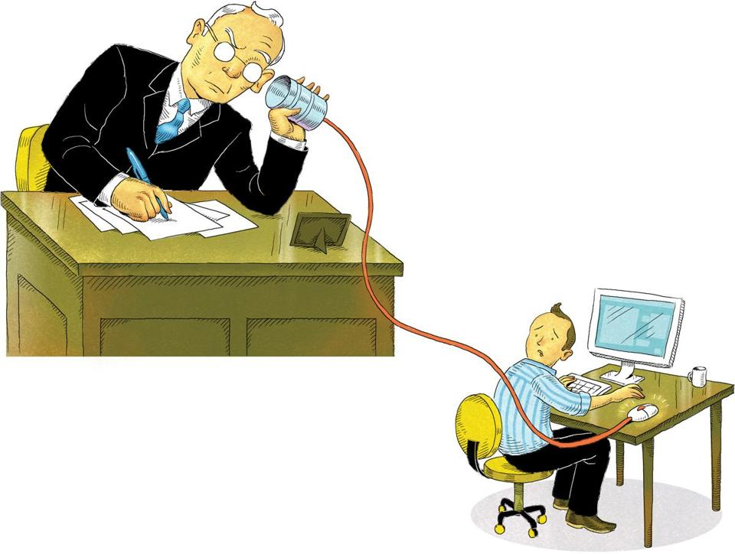
Privacy in the Workplace: Data Professionals as Data Subjects Erica Hanson Sept. 9, 2020

Slide 2
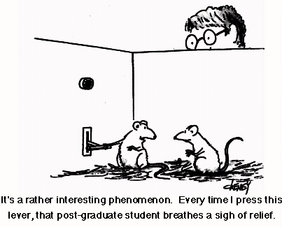
WHO AM I?
Background in Neurobiology of pain
Certified Information Privacy Technologist
Interning with the OHSU Privacy Office
Notes:
In the last few years of my dissertation I became increasingly concerned with the data ethics and privacy issues regarding healthcare data. Many of the concerns that I had about research ethics and design seemed to be championed within the Privacy field. I was inspired to shift to a career in information privacy and security.

Slide 3
Talk outline
Defining Privacy
The global regulatory environment
Sources of privacy protections in the US
Key regulations that are involved with protecting certain types of employee data
Real-world examples of employee data privacy concerns
Privacy by design
Notes:
“A brief overview of employee privacy concerns, US laws that enable or constrain privacy advocacy, and frameworks for thinking about privacy protections as designers, consumers and citizens”
Come up with discussion questions for a breakout session

Slide 4

What is Privacy?
Pluralistic concept
Depends upon the generation, culture, socio-economic status, familiarity with technology…etc
The idea of “Private life” as the internal thoughts, feelings, and activities of an individual, excluded from others, is a modern invention

Slide 5

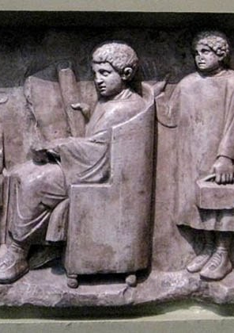
“Private life” was separated from political authority
Often the same as domestic life
But not restricted to the home, or excluded from communal spaces and social life
Notes:
In western history, and especially before the rise of central state power, the separation of “public” and “private” life was defined by a definition of the private as that part of life that was not subject to the authority of the government.
Private life was often synonymous with the domestic sphere, but additional “zones of immunity” could be found, for certain subjects, outside the boundaries of the home.

Slide 6


The rise of the modern centralized state shifted the boundary between private and public
Notes:
As state powers consolidated and grew stronger, along with the dual influence of emergence of the bourgeoisie class and the dominance of individualism in the modern period, the public realm was increasingly “deprivatized” and “private life” became identified with the home, family, and internal life of the individual.

Slide 7
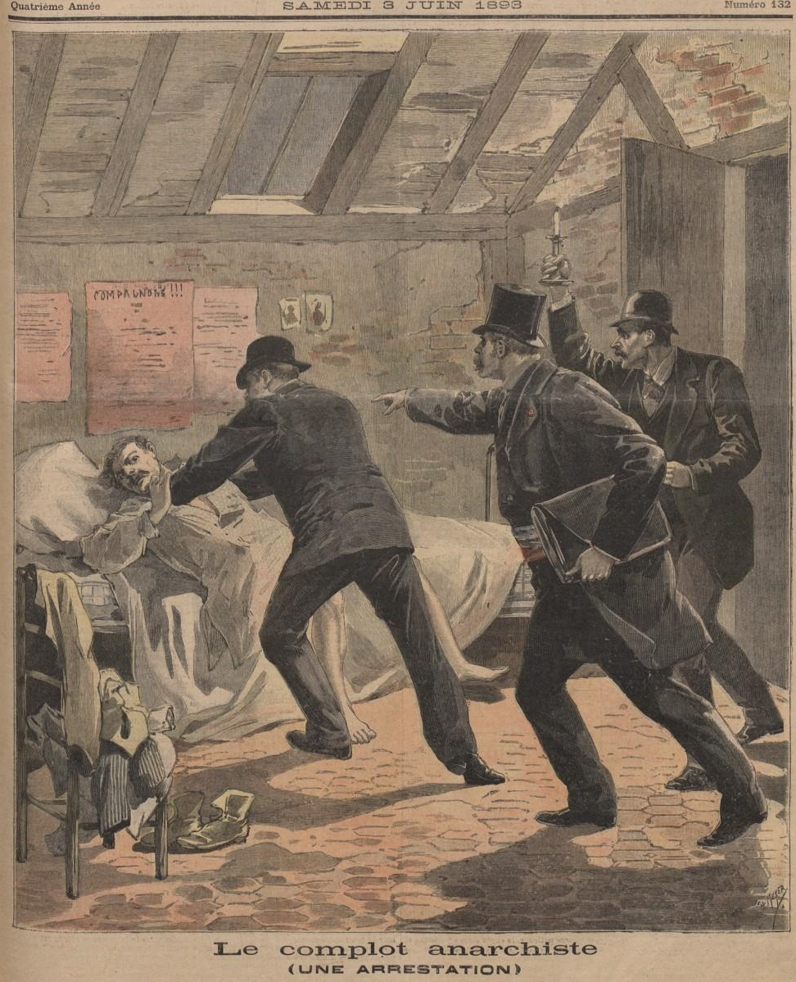
Private persons were not completely immune from increasing intrusions from the state
The legal arena became a source of privacy protections as well as the enforcement of norms through legal penalties
Notes:
Nonetheless, the affairs of private persons were not completely immune from the increasingly aggressive intrusions of the state. The legal arena becomes a source of privacy protections as well as the enforcement of certain norms through legal penalties

Slide 8
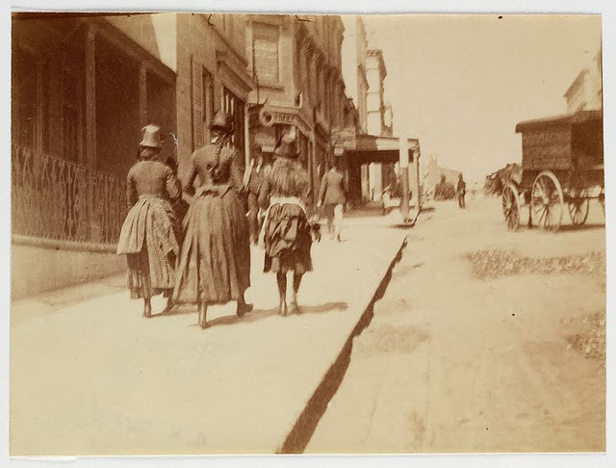
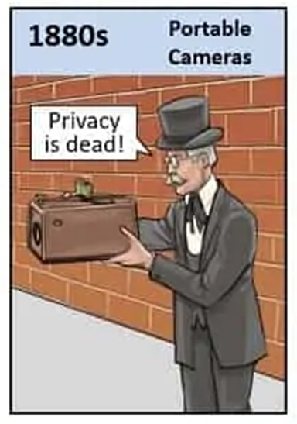
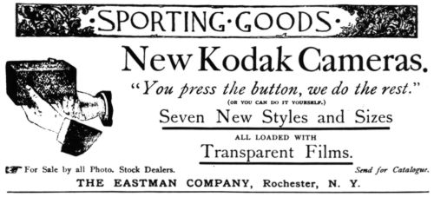
Notes:
Legal protections often trail tech innovations
One of the important moment was the invention of the brownie camera, advertised to women and children, and seen as democratizing
This sparked a backlash, and coincided with shifts in attitudes about privacy- people were more concerned with their personal privacy and visibility within densely populated cities

Slide 9
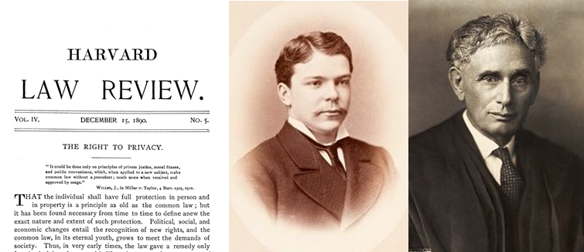
The privacy tort is “the right to be left alone.”
Definition: A tort is an act or omission that gives rise to injury or harm to another and amounts to a civil wrong for which courts impose liability.
Existing common law did not currently afford much of a legal protection of privacy.
Defamation law—the torts of libel and slander
Contract law
Property law
“The common law secures to each individual the right of determining, ordinarily, to what extent his thoughts, sentiments, and emotions shall be communicated to others.”
Notes:
Inspired in part by the newspaper, Samuel D. Warren and Louis Brandeis
Defamation law—the torts of libel and slander— protected against false information, not true private information.
Contract law could protect privacy within relationships formed between parties, but it could not protect against privacy invasions by third parties outside of the contract.
Property law was also inadequate to protect privacy.
Has been called one of the most influential law articles ever

Slide 10
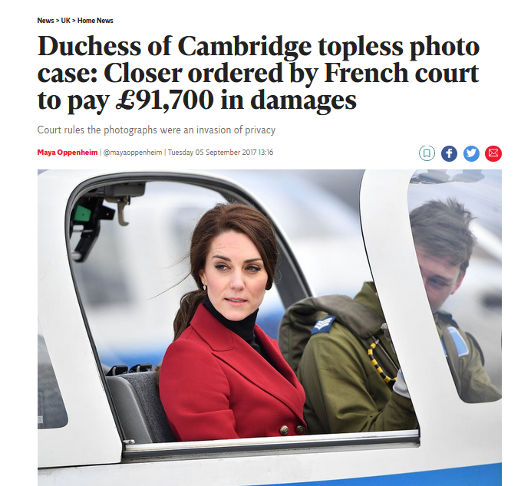
The four privacy torts
Intrusion upon seclusion or solitude, or into private affairs;
Public disclosure of embarrassing private facts;
Publicity which places a person in a false light in the public eye; and
Appropriation of name or likeness.
https://www.law.cornell.edu/wex/tort
Notes:
Tort expert William Prosser in 1960 surveyed over 300 privacy cases and concluded that they represented four privacy torts

Slide 11

Beyond the legal definition
“Privacy is not only about refusing access, visibility, or interference with particular decisions. It is also and more generally about preventing the seamless imposition of patterns predetermined by others.”
Julie E. Cohen, Configuring the Networked Self: Law, Code and the Play of Everyday Practice
Privacy is “the freedom from unreasonable constraints on the construction of one’s identity”
Mireille Hildebrandt, Smart Technologies and the End(s) of Laws
“Privacy forms the basis of our freedom. You have to have moments of reserve, reflection, intimacy, and solitude…”
Dr. Ann Cavoukian, former Information & Privacy Commissioner of Ontario, Canada
Notes:
As technologies have changed, our ways of thinking about and conceptualizing privacy have expanded and changed as well.
Hildebrandt- Professor of law and tech in Brussels
Cohen- Georgetown law

Slide 12
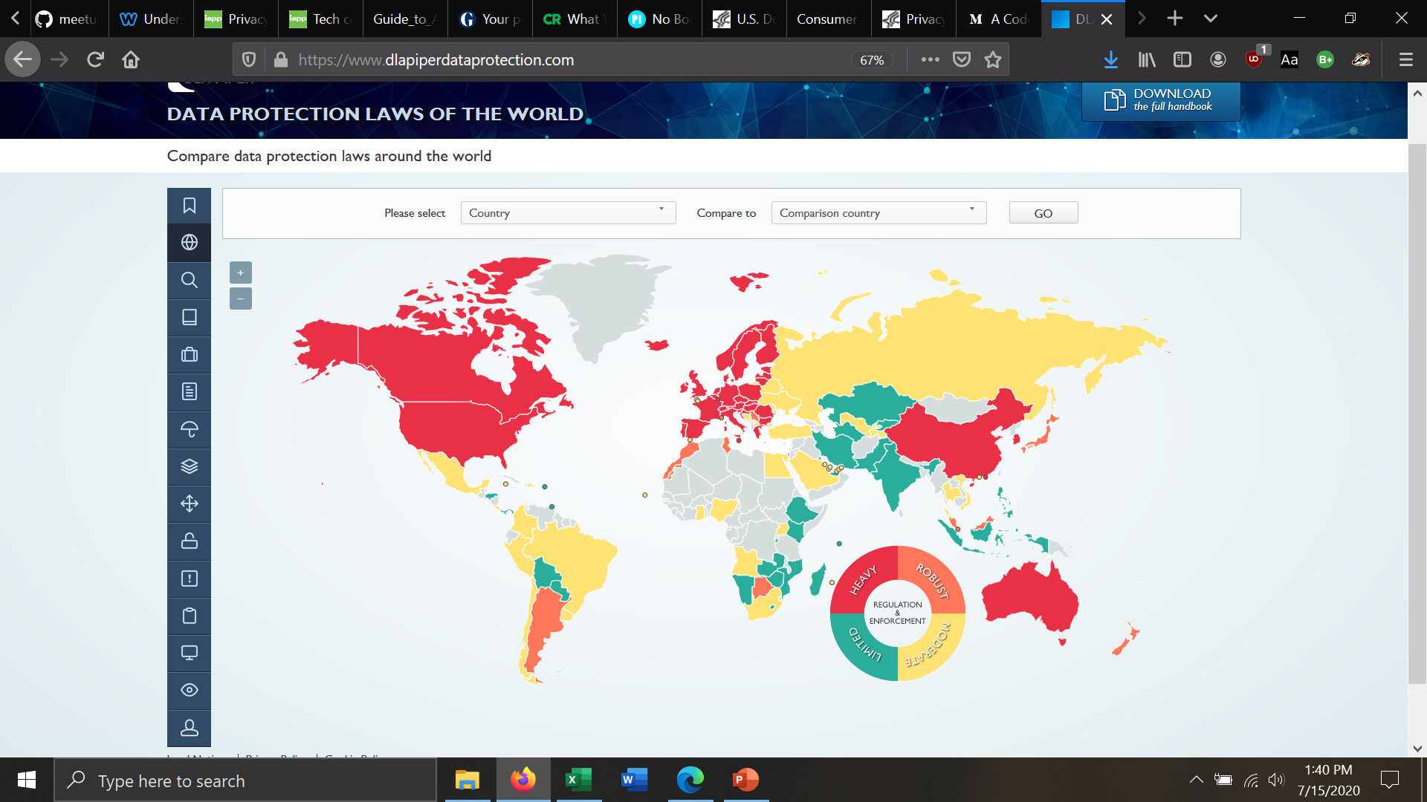
The global regulatory environment

Slide 13
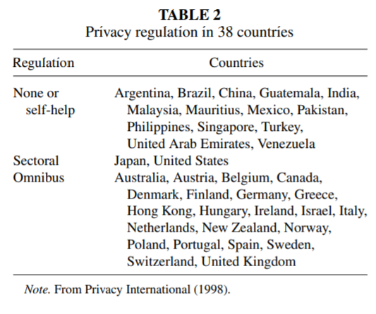
The global regulatory environment
EU- data subject and a rights framework
US- data types (health vs consumer financial)

Slide 14





Categories of privacy in the US
Healthcare
Consumer Financial
Education
Telemarketing and Marketing
Workplace (Anti-discrimination)

Slide 15
Where do Privacy protections in the US come from?
US privacy laws come from various sources
Common Law-Legal principles that have developed over time in judicial decisions (torts), often drawing on social customs and expectations.
Constitutions- Federal and state constitutions
Legislation
Regulations and Rules
Notes:
The word "privacy" is not in the U.S. constitution. However, some parts directly affect privacy such as the 4th Amendment which limits government searches.
“The right of the people to be secure in their persons, houses, papers, and effects, against unreasonable searches and seizures, shall not be violated, and no Warrants shall issue, but upon probable cause, supported by Oath or affirmation, and particularly describing the place to be searched, and the persons or things to be seized.”
State constitutions may create stronger rights than those found in the U.S. constitution. Generally follow the sectoral approach of protection according to data type
For example, CA state constitution expressly recognizes a right to privacy.

Slide 16
Important US laws and regulations
The Fair Credit Reporting Act (FCRA) 1970
Family Educational Rights and Privacy Act (FERPA) 1974
Protection of Pupil Rights Amendment (PPRA) 1978
Electronic Communications Privacy Act (ECPA) 1986
Computer Fraud and Abuse Act (CFAA) 1986
Employee Polygraph Protection Act (EPPA) 1988
Americans with Disabilities Act (ADA) 1990
FTC Telemarketing Sales Rule (TSR) Telephone Consumer Protection Act of 1991 - FCC regulations
Health Insurance Portability and Accountability Act (HIPAA) 1996
The Financial Services Modernization Act "Gramm-Leach-Bliley" (GLBA) 1999
Telephone Consumer Protection Act (TCPA) 1991
No Child Left Behind Act (NCLB) 2001
The Federal Information Security Management Act (FIMSA) 2002
Controlling the Assault of non-Solicited Pornography and Marketing Act (CAN-SPAM) 2003
The Fair and Accurate Credit Transactions Act (FACTA) 2003
Genetic Information Nondiscrimination Act (GINA) 2008
Health Information Technology for Economic and Clinical Health Act (HITECH) 2009
Dodd-Frank Wall Street Reform and Consumer Protection Act (Dodd-Frank) 2010
Notes:
FCRA: people might be familiar with this one because it allows for access to one’s credit report and provides an avenue to dispute inaccuracies in your credit history
A year after the HEW report, Congress passed the Privacy Act of 1974. The Act responded to many of the concerns raised by HEW. It regulates the collection and use of records by federal agencies, and affords individuals right to access and correct their personal information. Although the Act made important strides in bringing government information systems under control, the Act has a number of shortcomings. The Privacy Act does not apply to the private sector. Nor does it apply to state or local agencies.

Slide 17
Important US laws and regulations
ADA
The Fair Credit Reporting Act (FCRA) 1970
Family Educational Rights and Privacy Act (FERPA) 1974
Protection of Pupil Rights Amendment (PPRA) 1978
Electronic Communications Privacy Act (ECPA) 1986
Computer Fraud and Abuse Act (CFAA) 1986
Employee Polygraph Protection Act (EPPA) 1988
Americans with Disabilities Act (ADA) 1990
FTC Telemarketing Sales Rule (TSR) Telephone Consumer Protection Act of 1991 - FCC regulations
Health Insurance Portability and Accountability Act (HIPAA) 1996
The Financial Services Modernization Act "Gramm-Leach-Bliley" (GLBA) 1999
Telephone Consumer Protection Act (TCPA) 1991
No Child Left Behind Act (NCLB) 2001
The Federal Information Security Management Act (FIMSA) 2002
Controlling the Assault of non-Solicited Pornography and Marketing Act (CAN-SPAM) 2003
The Fair and Accurate Credit Transactions Act (FACTA) 2003
Genetic Information Nondiscrimination Act (GINA) 2008
Health Information Technology for Economic and Clinical Health Act (HITECH) 2009
Dodd-Frank Wall Street Reform and Consumer Protection Act (Dodd-Frank) 2010
HIPAA
Notes:
FCRA: people might be familiar with this one because it allows for access to one’s credit report and provides an avenue to dispute inaccuracies in your credit history
A year after the HEW report, Congress passed the Privacy Act of 1974. The Act responded to many of the concerns raised by HEW. It regulates the collection and use of records by federal agencies, and affords individuals right to access and correct their personal information. Although the Act made important strides in bringing government information systems under control, the Act has a number of shortcomings. The Privacy Act does not apply to the private sector. Nor does it apply to state or local agencies.

Slide 18




Americans with Disabilities ACT (ADA)
The Americans with Disabilities Act (ADA) prohibits discrimination against people with disabilities in several areas, including employment
The ADA defines an individual with a disability as a person who:
has a physical or mental impairment that substantially limits a major life activity
Has a record or history of a substantially limiting impairment
Or, is regarded or perceived by an employer as having a substantially limiting impairment.
Title I of the ADA protects the rights of both employees and job seekers
https://www.eeoc.gov/laws/guidance/job-applicants-and-ada#accommodation
Notes:
in several areas, including employment, transportation, public accommodations, communications and access to state and local government’ programs and services.

Slide 19

The Health Insurance Portability and Accountability Act (HIPAA)
The HIPAA privacy rule governs the use and disclosure of individuals’ health information—called “protected health information” by organizations subject to the Privacy Rule
Healthcare providers that conduct transactions in electronic form
Health insurers
Health clearinghouses
The Privacy Rule protects all "individually identifiable health information" held or transmitted by a covered entity or its business associate, in any form or media, whether electronic, paper, or oral. The Privacy Rule calls this information "protected health information (PHI)."
https://www.hhs.gov/hipaa/for-professionals/privacy/laws-regulations/index.html

Slide 20

The Health Insurance Portability and Accountability Act (HIPAA)
PHI, or “Individually identifiable health information” is information, including demographic data, that relates to:
The individual’s past, present or future physical or mental health or condition,
The provision of health care to the individual, or
Or, the past, present, or future payment for the provision of health care to the individual
and that identifies the individual or for which there is a reasonable basis to believe it can be used to identify the individual
Some examples:
name
Mother’s name or maiden name
birth date
Social Security Number
Biometric identifiers
IP and Mac addresses
https://www.hhs.gov/hipaa/for-professionals/privacy/laws-regulations/index.html

Slide 21

HIPAA: Is my data always protected?
I think I’ll share that on my wall.
No
You may *consent to the disclosure of your PHI at any time
https://www.hhs.gov/hipaa/for-individuals/employers-health-information-workplace/index.html
Notes:
Your employer can ask you for a doctor’s note or other health information if they need the information for sick leave, workers’ compensation, wellness programs, or health insurance.
However, if your employer asks your health care provider directly for information about you, your provider cannot give your employer the information without your authorization unless other laws require them to do so.
The Privacy Rule applies to the disclosures made by your health care provider, not the questions your employer may ask.

Slide 22

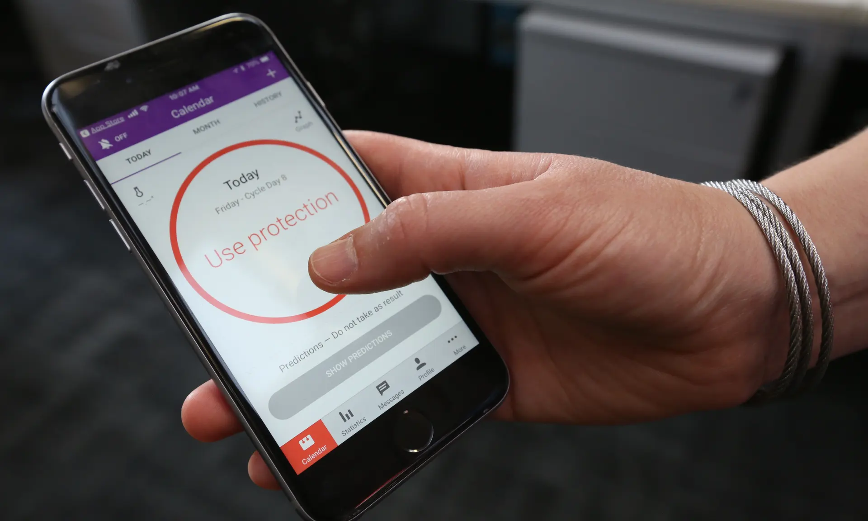

Health and wellness apps
Period tracking apps have been subject to serious privacy concerns
A 2018 study by Privacy International found that 61% of period-tracking apps automatically send data to Facebook
Information shared within a company hosted app is not necessarily private
Nor is it necessarily subject to privacy rules such as HIPAA that protect health information from wider disclosure
Notes:
Period tracking apps have been subject to serious privacy concerns, both from a consumer and an employee perspective
Experts worry that companies could use the data to bump up the cost or scale back the coverage of health-care benefits, or that women’s intimate information could be exposed in data breaches or security risks. And though the data is made anonymous, experts also fear that the companies could identify women based on information relayed in confidence, particularly in workplaces where few women are pregnant at any given time.

Slide 23
HIPAA: Is my data always protected?
I think I’ll share that on my wall.
No
You may *consent to the disclosure of your PHI at any time
The Privacy Rule does not protect your employment records, even if the information in those records is health-related
Additionally, there are no restrictions on the use or disclosure of de-identified health information
https://www.hhs.gov/hipaa/for-individuals/employers-health-information-workplace/index.html
Notes:
Your employer can ask you for a doctor’s note or other health information if they need the information for sick leave, workers’ compensation, wellness programs, or health insurance.
However, if your employer asks your health care provider directly for information about you, your provider cannot give your employer the information without your authorization unless other laws require them to do so.
The Privacy Rule applies to the disclosures made by your health care provider, not the questions your employer may ask.

Slide 24
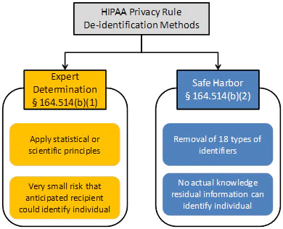
The De-identification Standard under HIPAA
2)(i) The following identifiers of the individual or of relatives, employers, or household members of the individual, are removed:
(A) Names
(B) All geographic subdivisions smaller than a state, including street address, city, county, precinct, ZIP code, and their equivalent geocodes, except for the initial three digits of the ZIP code if, according to the current publicly available data from the Bureau of the Census: (1) The geographic unit formed by combining all ZIP codes with the same three initial digits contains more than 20,000 people; and (2) The initial three digits of a ZIP code for all such geographic units containing 20,000 or fewer people is changed to 000
(C) All elements of dates (except year) for dates that are directly related to an individual, including birth date, admission date, discharge date, death date, and all ages over 89 and all elements of dates (including year) indicative of such age, except that such ages and elements may be aggregated into a single category of age 90 or older
(D) Telephone numbers
(L) Vehicle identifiers and serial numbers, including license plate numbers
(E) Fax numbers
(M) Device identifiers and serial numbers
(F) Email addresses
(N) Web Universal Resource Locators (URLs)
(G) Social security numbers
(O) Internet Protocol (IP) addresses
(H) Medical record numbers
(P) Biometric identifiers, including finger and voice prints
(I) Health plan beneficiary numbers
(Q) Full-face photographs and any comparable images
(J) Account numbers
(R) Any other unique identifying number, characteristic, or code, except as permitted by paragraph (c) of this section [Paragraph (c) is presented below in the section “Re-identification”]; and
(K) Certificate/license numbers
Notes:
Section 164.514(a) of the HIPAA Privacy Rule provides the standard for de-identification of protected health information. Under this standard, health information is not individually identifiable if it does not identify an individual and if the covered entity has no reasonable basis to believe it can be used to identify an individual.

Slide 25

Employee privacy… do we have any?
Yes, but employees can expect less privacy than in their personal lives
Courts have found that the (physical) employee workspace can be searched
Phone calls to/from work phones
Computers provided by the employer are also subject to search:
Email contents sent to/from work email addresses
Files saved to the computer
Monitoring activity on the device*
*More on this in a minute
Notes:
It’s important to note that many of the laws and regulations regarding privacy are written or enforced based upon an assumption that the data subject is a consumer

Slide 26


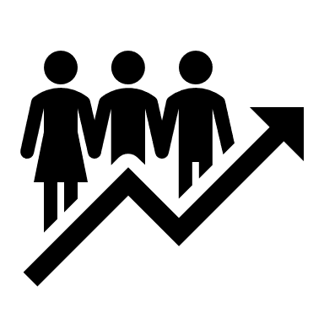

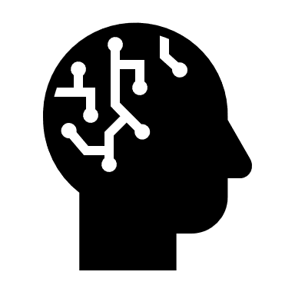
Common employee privacy concerns
Biometric access control
Workplace monitoring
Improving operational productivity
“Automated” decision-making
Further topics in AI

Slide 27
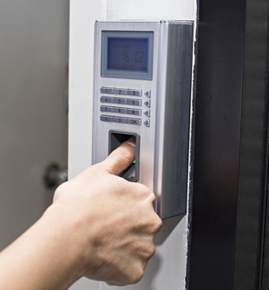
Biometric access control
A way to authenticate users based upon a physical attribute:
Fingerprint
Palm print
Finger veins
Iris scan
Voice and facial recognition
Nothing to remember or carry around Difficult or impossible for credentials to be lost/stolen
Pose a privacy risk as they uniquely identify an individual
Employees don’t always have much power to resist their use
Notes:
Jeremy Lee
https://phys.org/news/2019-06-biometric-recognition-technology-workplace.html

Slide 28



In 2018, a Queensland sawmill introduced fingerprint scanners, which at least one employee, Jeremy Lee, refused
Fingerprint scanning was used to monitor the clock-on and clock-off times at two sites
Lee wrote to his employer with concerns and refused to use the scanner
Lee was fired in February, and lodged an unfair dismissal claim in the Fair Work Commission of Australia
The initial unfair dismissal claim failed, though he won an appeal in 2019
https://www.theguardian.com/world/2018/nov/27/companies-can-sack-workers-for-refusing-to-use-fingerprint-scanners
Notes:
Biometric Information Privacy Act (BIPA) of 2008: BIPA requires employers to adopt policies regarding biometric data collection and retention, obtain consent before collecting biometric data, and take steps to securely store and protect from disclosure any biometric information that is collected.
Scientists have developed a catalogue of DNA mutation 'fingerprints' that could help doctors pinpoint the environmental culprit responsible for a patient's tumor - including showing some of the fingerprints left in lung tumors by specific chemicals found in tobacco smoke.

Slide 29
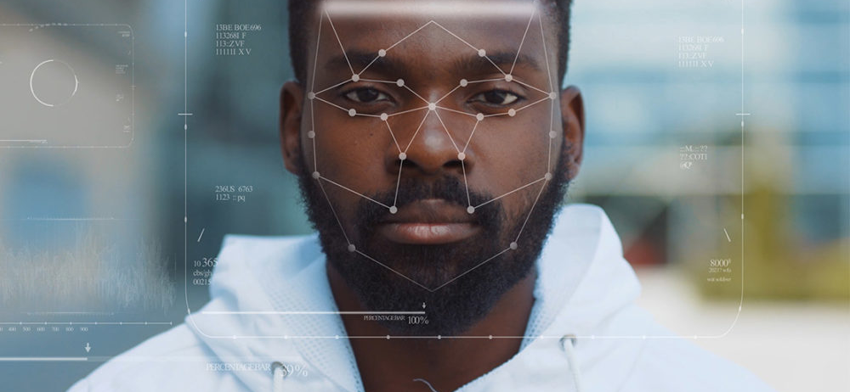
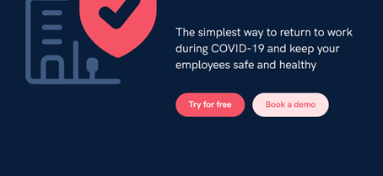
Biometric access control
Joy Buolamwini and Timnit Gebru’s 2018 research found some facial analysis algorithms misclassified Black women nearly 35% of the time
SINE- promises to use facial recognition and other tracking technology to enforce social distancing
“Quickly contact trace suspected cases with full visibility and automatic logging of all movements through your site.”
Notes:
Using facial recognition for access control can lead to other issues, such as the introduction of racial bias
There is a risk with the “emergency” adoption of these technologies that use-cases will change after the crisis ends without reverting to privacy-centric practices

Slide 30

Workplace monitoring
Legally, employers generally have broad powers to monitor activity
Reasons to do so include data privacy and access management, security and productivity
Keeping track of what they type
Recording Internet activity
Taking screenshots
Using a device’s webcam
Noting which employees access what files and when
Monitoring an employee’s physical location using GPS
Measuring the employee’s productivity, such as noting a computer’s idle time or how long an app or piece of software remains open
https://www.forbes.com/sites/tomspiggle/2020/05/21/can-employers-monitor-employees-who-work-from-home-due-to-the-coronavirus/
Notes:
Employee surveillance has increased dramatically during the pandemic, but has been increasing over the last decade as companies permit more telecommuting and teleconferencing

Slide 31
Workplace monitoring
Legally, employers generally have broad powers to monitor activity
Reasons to do so include data privacy and access management, security and productivity
Keeping track of what they type
Recording Internet activity
Taking screenshots
Using a device’s webcam
Noting which employees access what files and when
Monitoring an employee’s physical location using GPS
Measuring the employee’s productivity, such as noting a computer’s idle time or how long an app or piece of software remains open
https://www.forbes.com/sites/tomspiggle/2020/05/21/can-employers-monitor-employees-who-work-from-home-due-to-the-coronavirus/
Are these metrics justified?
Notes:
Much of this discussion is centered around white-collar workers, but by no means should this suggest that white-collar workers are more surveilled than blue-collar or other more precarious employees. Far from it.

Slide 32
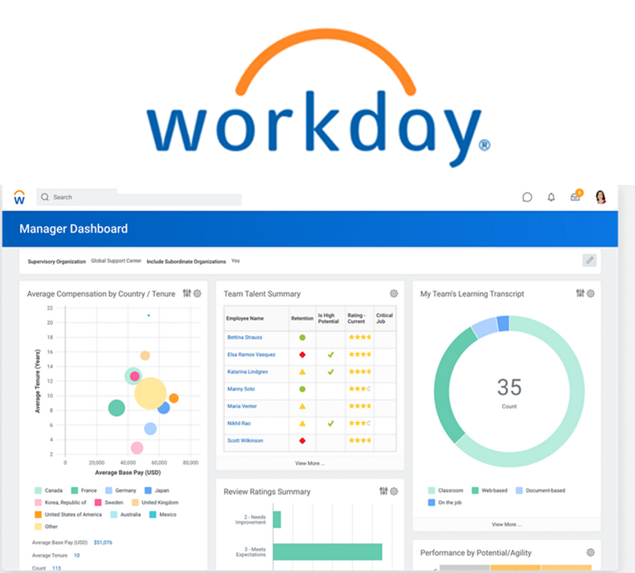
Improving operational productivity
WORKDAY provides “people analytics”
Examines 60 factors to predict which employees are likely to quit, to be disgruntled, and how the employer might best retain the best employees
Factors include the time an employee takes between days off for vacations or changes in the individual’s supervisor

Slide 33

“Automated” decision-making
AI can generate bias, and it can be difficult to detect and remedy bias in algorithmic decision-making
Proving that discrimination occurred can be especially challenging

Slide 34

HireVue
HireVue uses a proprietary algorithm to assess traits like “emotional intelligence”, “cognitive ability” and “Psychological traits”
EPIC, the Electronic Privacy Information Center filed a complaint with the FTC that HireVue has committed unfair and deceptive practices in violation of the FTC Act
EPIC charges that HireVue violates the Federal Trade Communications Act because it lacks a “reasonable basis” to support its claims and cannot be held accountable for the proper functioning of its secret algorithmic assessments
Notes:
HireVue issued a press release in September announcing it has partnered with Integrate Autism Employment Advisors, a nonprofit organization that helps companies recruit “qualified professionals on the autism spectrum.” The 600 candidates in Integrate Autism’s network will be coached on how to use HireVue’s platform more “efficiently and effectively.” Would such an effort be necessary if HireVue’s algorithm didn’t penalize autistic candidates.

Slide 35

What can an employee do to protect their own privacy?
Know your rights!

Slide 36



Employer demands for social media log-in credentials
Courts in many cases have sided with employee plaintiffs
Almost half of US states (including California, Virginia, and Illinois) now protect applicants and employees from having to provide social media passwords to employers or otherwise give employers access to their accounts
Notes:
Since Maryland passed its law in 2012, many other states have followed suit. Nearly half of the states (including California, Virginia, and Illinois) now protect applicants and employees from having to provide social media passwords to employers or otherwise give employers access to their accounts. More states consider passing these laws each year.
In many cases, employers can ask for you to provide a lot of personal data, but that doesn’t mean that every request must be complied with.

Slide 37

What can an employee do to protect their own privacy?
Be mindful of your social media trail
Notes:
Anything that you post publicly on social media is legally accessible by employers (current or potential) or by data brokers who can then provide that information to employers to influence employment decisions.

Slide 38


Big Data and ADA
ADA protections cover past and present “perceived” impairments, but do not currently protect against predictive technologies, argues Sharona Hoffman
Information about employees can be gathered from a wide range of sources, including internal and external sources such as from social media, wellness programs (and wellness apps), and data brokers, etc
Notes:
Additionally, impairments resulting from pregnancy (for example, gestational diabetes) may be disabilities under the Americans with Disabilities Act (ADA). An employer may have to provide a reasonable accommodation for a disability related to pregnancy, absent undue hardship (significant difficulty or expense).

Slide 39

What can an employee do to protect their own privacy?
Read privacy notices and use apps thoughtfully
Notes:
This can be challenging and boring

Slide 40

Consent in the US privacy regime
The Fair Information Practice Principles (FIPPs) in the mid-century partially instantiated the new language of “control” as a proxy for privacy rights
But Woody Hartzog, has said that:
“[T]he control companies promise people is an illusion…. Companies decide the kind of boxes people get to check, the buttons they press, switches they activate and deactivate, and other settings they get to fiddle with.”
Notes:
As long as the data subject was able to exert “control” over their data, there aren’t additional barriers to its collection, use and disclosure
Woody Hartzog, professor of Law and Computer Science at Northeastern

Slide 41
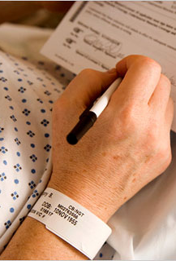
The problem with “consent”
Long, complex privacy notices can lead to “click-fatigue”
Exactly what data is collected, for what purpose, and how it is processed can be difficult to determine; this asymmetrical knowledge benefits the data processor
The concept of “control” remains central in the US, and encourages the argument that data subjects should be paid for access to their data as a means of both redress and rights

Slide 42


What does it mean for an employee to consent?

Slide 43



Activision
The data given to employers raises concerns “with their lack of general clinical applicability and focus on variables that affect time out of work and insurance utilization.”
Activision employees were encouraged to use a family-planning app, Ovia
Employees were incentivized to share as much information as possible
That information was then shared the data with the company
“De-identified,” aggregated health data was shared to an internal website accessible by Activision’s HR
Paula M. Castano, MD, MPH
Board Certifications:
Gynecology, Obstetrics and Gynecology
Notes:
Period tracking apps have been subject to serious privacy concerns, both from a consumer and an employee perspective
Experts worry that companies could use the data to bump up the cost or scale back the coverage of health-care benefits, or that women’s intimate information could be exposed in data breaches or security risks. And though the data is made anonymous, experts also fear that the companies could identify women based on information relayed in confidence, particularly in workplaces where few women are pregnant at any given time.

Slide 44
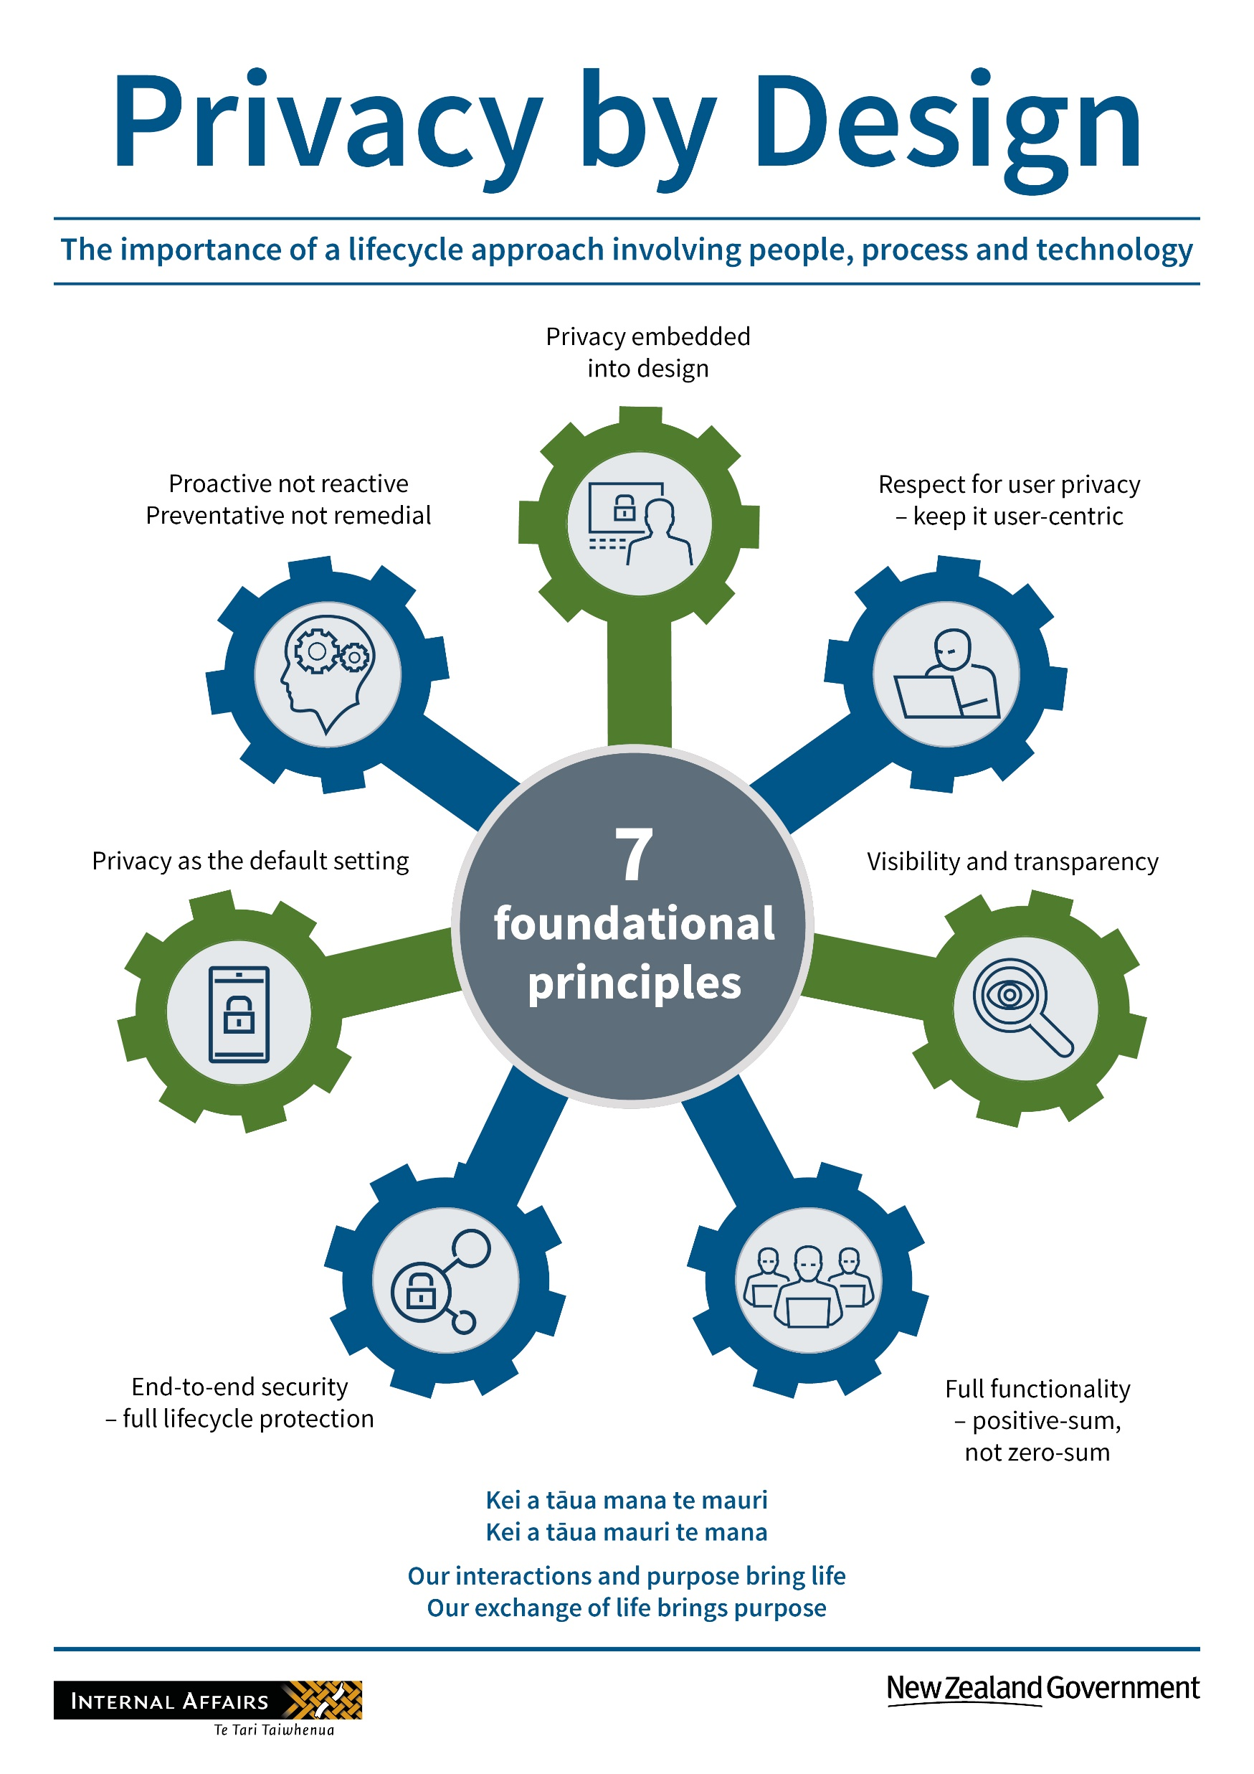
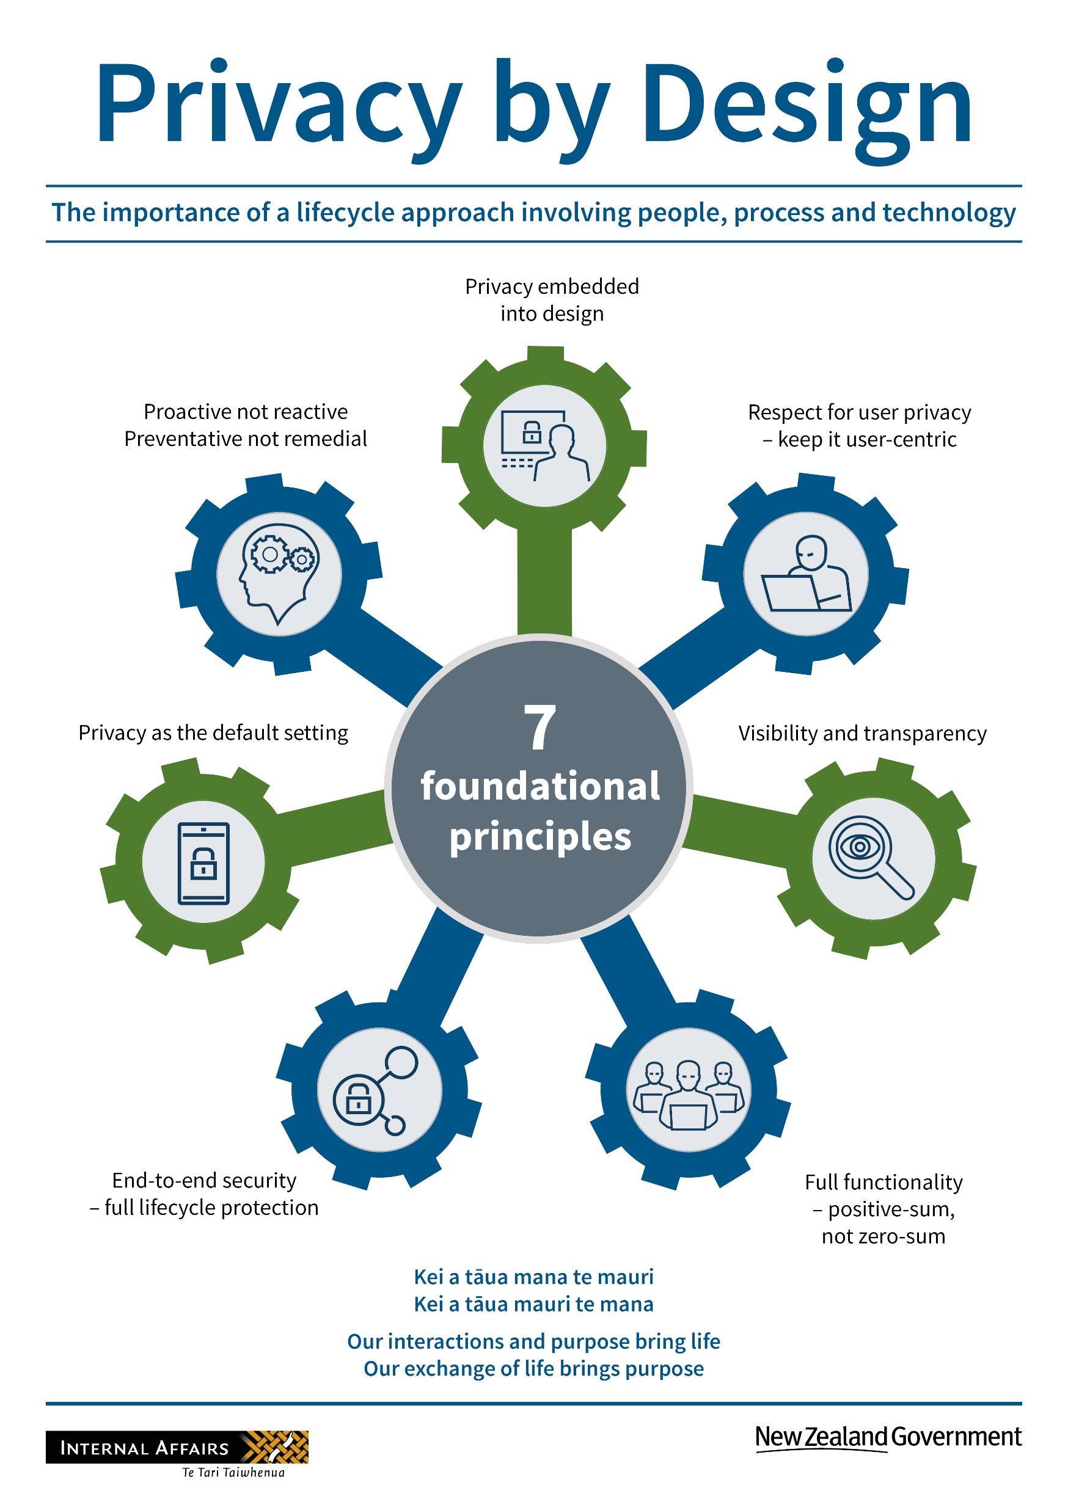
Privacy embedded into design
Proactive not reactive
Respect for user privacy

Slide 45
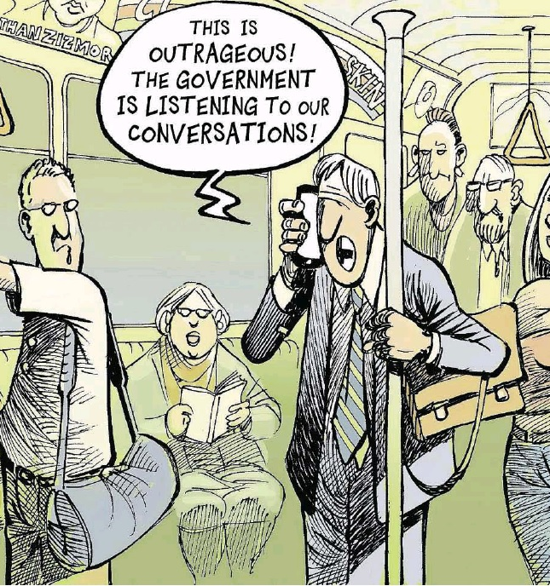
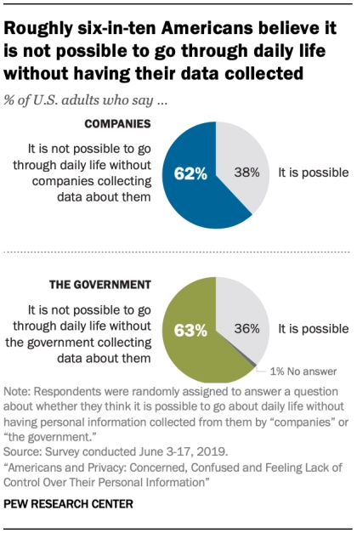
Myth of the privacy paradox
People say that they value privacy highly…
But share their personal data in exchange for very little or fail to use measures to protect their privacy

Slide 46
Privacy embedded into design
Proactive not reactive
Respect for user privacy
Privacy as the default setting
End-to-end security
Full functionality
Visibility and transparency

Slide 47
